Slide 1
BLUESAT Dice Kit
Soldering Workshop
Welcome!

Slide 2
Safety

Slide 3
Components

Slide 4
Soldering

Slide 5
Placement

Slide 6
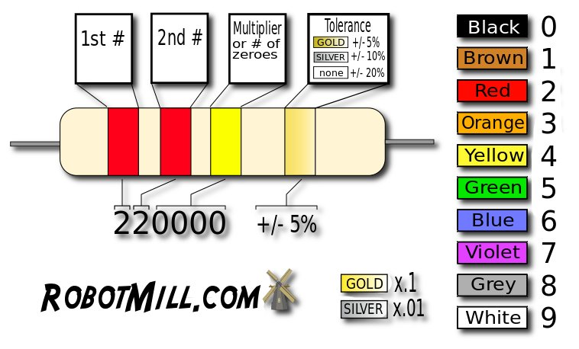
Resistors

Slide 7
Good luck!

